Slide 1
5 Alive Training for Program Leaders
Social Policy Research Associates
February 26, 2025
Notes:
This training focuses on the implementation of the 5 Alive Student Assessment and the 5 Alive Staff Survey .
As you enter, please download the materials if you haven’t already [link to training workbook: https://docs.google.com/document/d/1_lYoc9gQb1HqXI4sA5txgHeZZdc5OiVy/edit?usp=sharing&ouid=118381574480168555135&rtpof=true&sd=true].
As far as materials go, we are really just going to stick with the training workbook today. But I do want to make everyone aware that the SEL Toolkit site is now up! This is a sort of hub for you where you can find the 5 Alive Student Assessment and rubrics, the 5 Alive Student Assessment Data Form, the 5 Alive Staff Survey, a User Guide, and many more resources.
Here is the link if you want to check out that website as we wait for the final folks to roll in. : https://www.sjplf.org/san-jose-learns-resources/

Slide 2

Agenda
Welcome and Icebreaker
Survey Tool
5 Alive Student Assessment Part 2
Closing
Notes:
Welcome everyone. We are so glad to have you here to join us in our second training where we will dive deeper into the 5 Alive tools and how program leaders can leverage them to support SEL programming. These tools, the 5 Alive Staff Survey and 5 Alive Student Assessment, were originally co-developed with a group of expanded learning programs who were interested in developing better ways to assess social emotional learning in their programs. Both tools would ideally work as part of your SEL programming or continuous improvement cycles. We will discuss exactly what that looks like today.
We will start the day with an icebreaker. After that we will discuss the survey tool. One of our goals for today is that everyone here can become more familiar with the SEL 5 Alive Staff Survey. Our December training focused more on the assessment so we wanted to make sure we touched on the survey as well. Next, and the bulk of this training, we will discuss implementing the 5 Alive Tools. We hope that you will walk away with tips and strategies for administering the tools by the end of this segment as well as a better sense of how the data from both tools can inform your SEL programming. Finally, we hope you will stick around for our closing where we will update you on upcoming engagements and ask for feedback. It may not look like a lot but I promise it is and we are hoping you all will engage with us throughout. So let’s get this party started with our icebreaker.

Slide 3

Ice Breaker
Notes:
Hi everyone! Thanks again for joining us! Today for our ice breaker, please share either a self care activity you are planning to do this week or your favorite self care activity. We’ll open up breakout rooms for you to discuss and I’m hoping people get inspired and learn new ways to take care of themselves! We’ll open those up now and bring you back in 5 minutes.
What is one self-care activity you plan to do this week? / What is your favorite self-care activity?

Slide 4

5 Alive Staff Survey
Notes:
For those of you less familiar with the 5 Alive Tools, the 5 Alive Staff Survey is a survey for instructors where they can share evidence of student SEL development, gauge their own readiness to implement SEL, and share any support they may need. Both the 5 Alive Student Assessment and the 5 Alive Staff Survey tie to the 5 competencies in the CASEL framework and one focus skill within the competency. Regardless of what curriculum your program uses or if you incorporate SEL without using a formal curriculum, both tools can be implemented with a focus on specific skill development. For instance, instead of the survey and assessment focusing on the competency Relationship Skills, it focuses on the skill effective communication. Because we haven’t done a deep dive into the survey yet, I want to take some time during this training to discuss the tool before we start thinking about implementation.

Slide 5




Survey Content
Respondent Background
EXAMPLE: Student SEL Development
What evidence of increased communication skills have your observed in your students over the last 30 days? (Check all that apply).
  More respectful interactions between students
  Improved communication around difficult subjects
  Increased usage of conflict management strategies
  Increased use of language and phrases taught in lessons
  N/A (We did not focus on this topic)
  None of these
  Other) _______________
Student SEL Development
Provide evidence of student improvement in a given CASEL focus skill (see example to the right)
Needed Staff Support
Reflect on their access to the resources they need to support student SEL development
Staff Implementation of SEL
Indicate how often they provide various opportunities for students to develop focus skills
Notes:
NOTE: THIS SLIDE HAS ANIMATION
So what’s in the survey? Some of you either through the homework assignment in the training workbook or helping us pilot may already be familiar with the survey and its 4 main sections. For those of you who are less familiar, feel free to peruse the survey as I quickly review the content.
First, we have the Respondent Background section where classroom instructors identify: their school district/site, how long they have been at the site/school, their role, the recent activities they have led, and how frequently they led activities.
Next, the Student SEL Development asks instructors to provide evidence of student improvement in a given CASEL focus skill (see example to the right).
Then, the Needed Staff Supports ection has likert scale (agree and disagree) and open-ended response questions for instructors to reflect on their access to the resources they need to support student SEL development
Lastly, the Staff Implementation of SEL as instructors to indicate how often they provide various opportunities for students to develop focus skills
Although it was quick, hopefully that provides some idea of what you will find in the survey. Let’s take this a step deeper on the next slide.

Slide 6
Survey Refresher
Imagine you are an expanded learning instructor. How would you feel taking this survey?
Was there anything you would want to tailor for your program needs?
How might your program use the survey data?
Discuss the survey in small groups. You will have 5 minutes. Please refer to the questions on the right to guide your conversations.
Notes:
Now we want to give you some time to sit with the survey and think what it may mean for your program. If you haven’t already, please open up the survey and go ahead and open up your training workbook. On page one of your workbook is the homework assignment where we asked you to complete the survey and answer the questions on this slide. No worries if you were not able to complete the assignment, just make sure to have the survey open.
For this next part, we will break into small groups and discuss the survey for 5 minutes. Use the questions on the slide (which are the same as the ones in your homework) to guide your discussions.

Slide 7
Considerations for using the survey
Google Forms can create charts and tables.
The question bank has supplemental survey items you can add.
All program staff can contribute to conversations about the survey data.
There are different points of time when it may be helpful to administer the survey.
Notes:
NOTE: THIS SLIDE HAS ANIMATION
So we just heard what the survey might look like at your program. We want to present a few considerations we thought of as well.
[Google forms can be used automatically to help with analysis. In other words, programs don’t need to spend time creating graphs or tables themselves. Google will do it for you.
Next, we encourage programs to tailor the Staff Survey to serve their specific needs. The question bank provided in the Appendix of the User Guide can help with this. So by pulling from our list of suggested survey additions, you can more easily add items to the Staff Survey.
All program staff can reflect on the survey data and participate in discussion around SEL development. We will talk more about this point later.
Lastly, there are different points of time when it may be helpful to administer the survey. For instance, you may consider moving some of the 5 Alive questions to your general survey so staff only have to do one longer survey instead of two. You may see this as a tool to onboard new staff. Or perhaps you could administer this multiple times during the school year. There are a number of scenarios worth considering when thinking of the best time to administer.
That concludes our review of the 5 Alive Staff Survey. Let’s talk about the assessment and implementation.

Slide 8

5 Alive Student Assessment Part 2
Notes:
Hopefully you were all at our first 5 Alive training when we talked about how to administer the assessment with students. Today, we’re going to talk a little more about how to prepare on the back end, how you all as program leaders can support your staff and use the assessment to strengthen your program. But we’re going to start with a quick reminder about what this tool is. The 5 Alive Student Assessment is an assessment a student completes to help them reflect on their own understanding of SEL concepts and skill development. It’s divided into five mini-assessments, each of which is focused on specific social emotional skill. We’ll walk through the assessment of effective communication to job your memory.

Slide 9

Multiple Choice Question
Sasha and Peter got into an argument at school. Which choice(s) demonstrates good communication:? Check all that apply.
Sasha uses "I feel" statements when talking with Peter about her emotions.
Sasha ignores Peter for the rest of the day.
Peter asks Sasha how she is feeling and listens attentively to what she says.
Peter tells all his other friends that Sasha is mean.
Notes:
It starts with a quick multiple choice questions based on a short scenario that a student might be familiar with, and some options about how a student can respond. This is a bit of a warm-up to get the students thinking about the competency and focus skill.

Slide 10
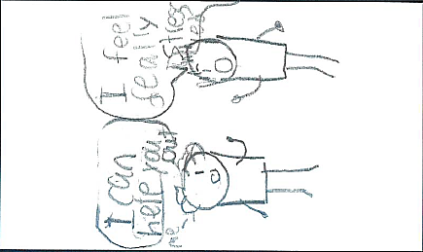
Drawing/Writing Activity
Directions: Draw or write about a time when you spoke or listened effectively.
Notes:
Then, students have a chance to draw or write about up to three times that they demonstrated the focus skill.

Slide 11
Student Reflection Questions
When you think about {insert skill}, what comes to mind? How would you describe {insert skill} to a friend?
Please tell me about your drawings and descriptions. What did you draw? Why did you choose to draw that?
Did you enjoy this activity? What was your favorite part? What was your least favorite part?
Notes:
And finally, the instructor administering the assessment asks students some reflection questions. This can be done individually or in small groups.

Slide 12
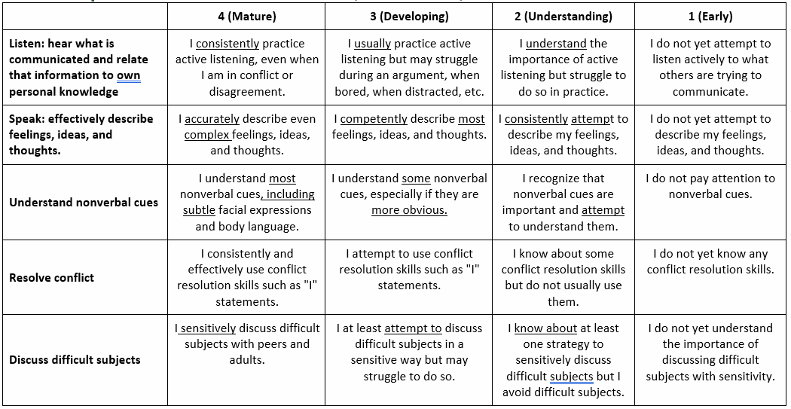
Assessment Rubric
Notes:
After students complete the assessment, instructors can use this rubric to determine where they fall along the continuum of developing these skills.
As a reminder, scores should be whole numbers and students will get one overall score, not a score for each row in the rubric. So instead of just scoring the listening row, you would have one cumulative score that represents their holistic understanding and development.

Slide 13
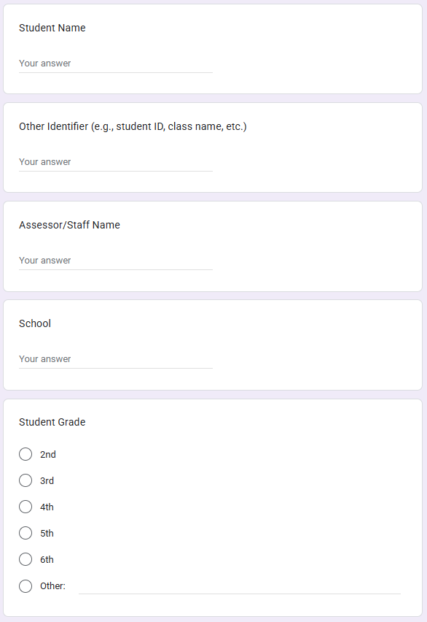
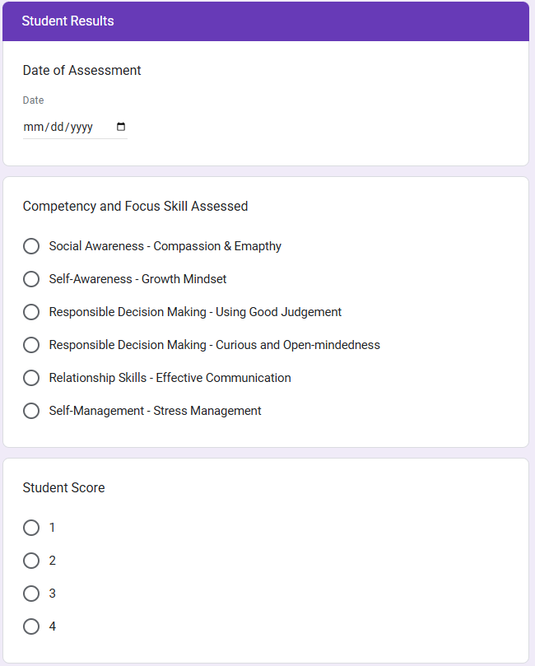
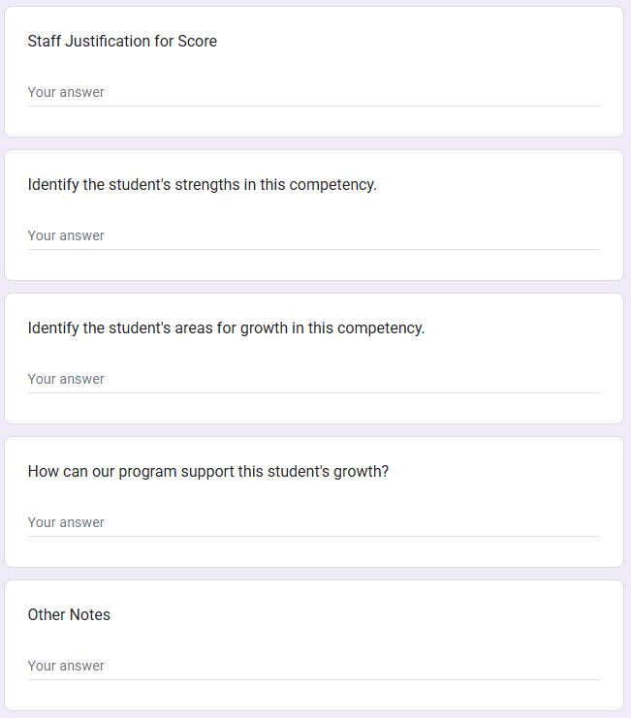
Student Assessment Data Form
Notes:
After you complete the assessment, staff enter their results in the student assessment data form.

Slide 14
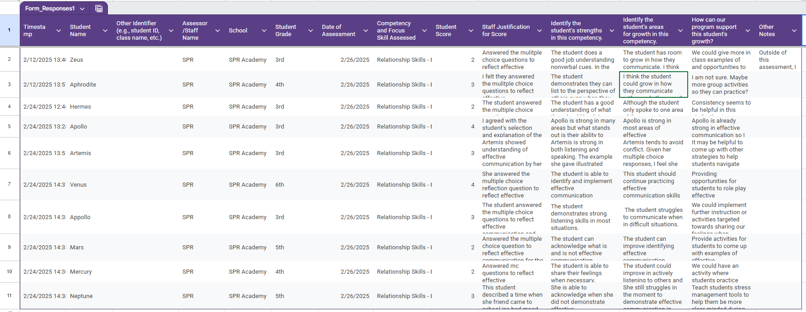
Google Sheet Export from Data Form
Notes:
After all of the student assessments have been entered into the data form, you can export a Google sheet that will look like this. (Read the fields out loud)
We went into a lot of detail about all of this in our first training, so we’re not going to talk too much about it today. If you need a refresher, there’s a lot of information in the user guide and there’s a recording from part 1 of our training that you can refer to.

Slide 15
Stages of the Assessment
Prepare
Identify purpose of assessment
Determine logistics
Prepare staff
Review tool with student
Administer
Score the results
Prepare the data
Prepare questions ahead of time
Hold conversations
Plan for next steps
Assess
Analyze
Notes:
In part 1 of this training, we also discussed the general steps of administering the assessment, which you’ll see displayed on this slide. First, you prepare. You think about why you want to use the assessment. Figure out logistics, and train and prepare your staff. We’ll talk about this in more detail in a minute.
Next comes the assessment stage. Which, again, you can refer to our part 1 training for a refresher on this.
And then finally, there’s the analysis stage. This is where you get to take a look at the results to get some more insight into your students and how you can further develop your program. This process if probably very familiar to all of you who regularly engage in a continuous quality improvement process.
Ask if there are questions.
Now, we’ll dive a little deeper into the preparation and analysis stages.

Slide 16

Preparation
Identify purpose of assessment
Determine logistics
Prepare staff
Notes:
The primary three steps at the preparation stage are to identify the purpose of the assessment for your program, because it can be used in different ways. Then you start figuring out the logistical pieces—how can this be smoothly integrated into your programming? And finally, you train and prepare you staff. And now we’ll go into some more details.

Slide 17
1) Identify how the tools will be integrated into your SEL programming
Preparation
Step1: Identify purpose of assessment
    Opportunity for student reflection?
    Chance for individual staff members to assess student understanding?
    Data to assess your curricula, lessons, or approaches?
Notes:
First, as a program, your team should determine how this tool will be integrated into your afterschool programming. Spend some time thinking about what you hope to get out of the tool. Is it a chance for students to reflect on their own growth? A chance for individual staff members to assess how well their students are understanding the concepts? Will you use the results to assess the curricula, lessons, or approaches that you have used to support SEL development?
There are a lot of different ways the assessment can be used and the answers to these questions can help you figure out some of the logistical pieces.
It’s also important to think about how this assessment could potentially become a part of your formal CQI process. How does it align with or complement what you are already doing?
Now, we’ll spend some time in break out rooms thinking through how you can use the assessment. Nikkolette is going to add some discussion prompts to the chat and then we’ll send you off into breakout room to discuss for five minutes.

Slide 18
Preparation
Step2: Determine Logistics
  Will students will complete the assessment individually or in small groups?
  Who will administer the assessment? Is additional staff needed?
  When will assessment the occur?
The Appendix A logistics worksheet can help!
Notes:
The second step of preparation is to determine logistics for administering the 5 Alive Student Assessment. Some of these may include
if the assessment will be administered to students individually or in groups,
Identifying the staff member who will administer to students as well as any additional staff that may be needed as support or to cover the other students while the assessment is taking place,
And the timing of the assessment.

Slide 19
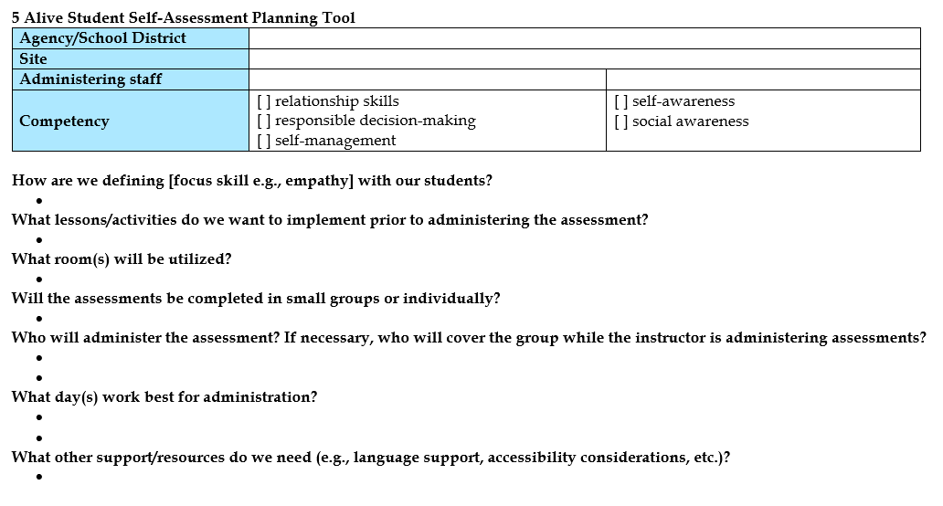
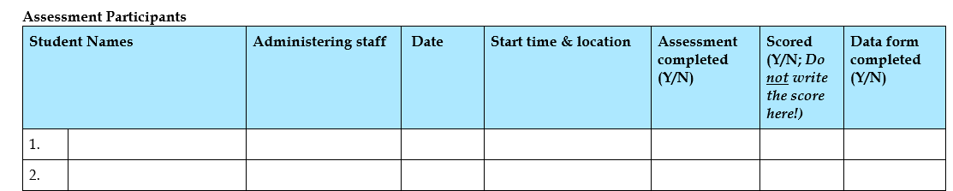
Notes:
To help with this, you can use the logistics worksheet which is located in appendix A of the User Guide which you can find on the San Jose Public Library Foundation website!
https://www.sjplf.org/san-jose-learns-resources/
This worksheet includes questions to help with logistics considerations as well as a place to keep track of assessments in the process of being scheduled and that have been completed.

Slide 20

Preparation
Step3: Prepare staff
Hold training
Provide time for them to prepare
Notes:
The last step of the preparation phase is preparing staff to administer the assessment. This includes holding a training, which could be similar to what we did in the part one trainings, which you can also find on the San Jose Public Library Foundation website. It is also important to make sure administrating staff have adequate time to prepare for the assessment to review the User Guide and the components of the tool.

Slide 21

Break

Slide 22

Analyze
7) Prepare the data
8) Identify questions to guide conversation
9) Hold conversations with staff
10) Plan for next steps
Notes:
We’re now going to turn to analyzing your data and thinking about how it can inform your program. This involves four primary steps, preparing your data,

Slide 23
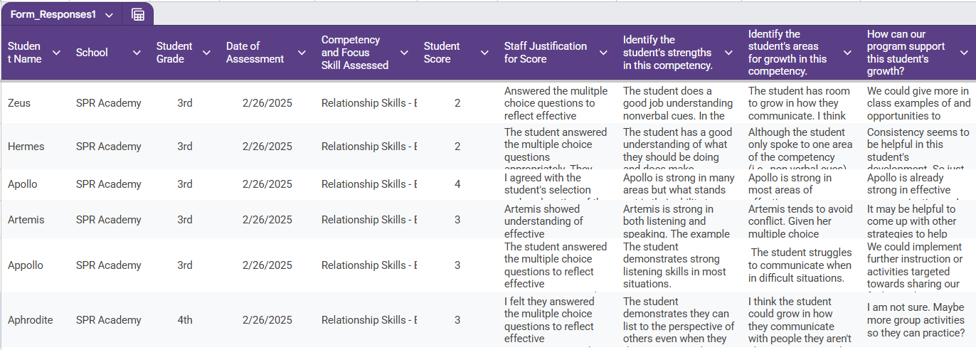
Analyze
Step 7: Prepare the data
First, download the data from the Data Capture Tool on Google docs.
Insert screenshot?
Notes:
So, let’s set the stage. Your team has administered the assessment and the results are in! You download the data from the Student Assessment Data Form on Google docs and it looks something like this. You might feel overwhelmed by all the scores and thoughtful reflections from the student assessment data. What do you do? How can we prepare all this data for staff to make sense of it later?

Slide 24

Analyze
Step 7: Prepare the data
What sort of visuals will help make sense of the data?
What other data might you incorporate?
Should data be organized by site, grade, or other characteristics?
Notes:
Well, remember that first step in the preparation stage? Identify the purpose of your assessment. Think back to your agreed upon purpose. This may help you think through what to do with this data. There are a number of factors that you may want to consider.
1) What sort of visuals will help you make sense of the data?
You’ll want to think through how to visualize the scores, which can be depicted by any type of graph that you can make with numbers, but also how you can present the other information from the data form, like students’ strengths and areas for growth. Things that were written out in text.
We’ll talk about different way that you can visualize both types of data and information.
2) What other data might you incorporate?
For example, Perhaps you already put together student profiles with data from many different sources, and you use these to guide conversations about how to best serve individual students. You can add this information to those student profiles as well.
3) Should data be organized by site, grade, or another characteristic?
Perhaps in Step 1, your team discussed wanting to know if English Language Learners were able to effectively engage in your SEL lessons, and you want to focus on them.

Slide 25
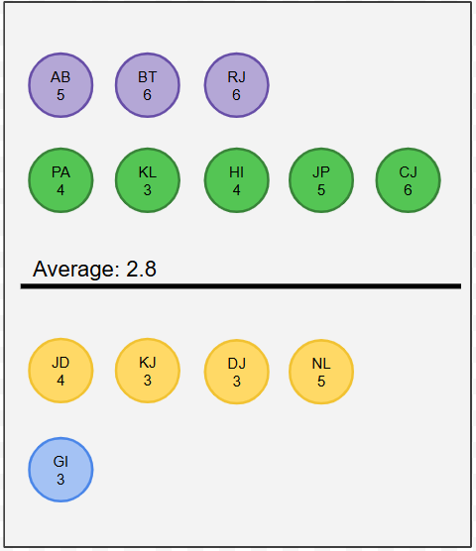
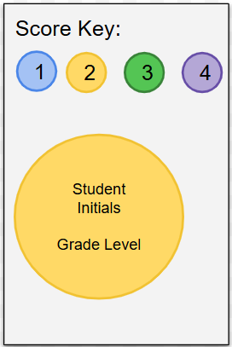
Analyze
Step 7: Prepare the data
Comparison of Individual Scores to Average Score
Notes:
Great, we want to share some examples of how you can present the student scores to help you make meaning of the data.
As you can see here, we have arranged some fictitious student scores on this number line. We added a line representing the average score and arranged sticky notes to demonstrate how each student scored. We color-coded the sticky notes to make it easier to see their score.
It might be fruitful to ask staff if they see anything surprising or if the results aligns with what they expect.
You can also color-code the results by other characteristics, such as site, grade, or EL designation.

Slide 26
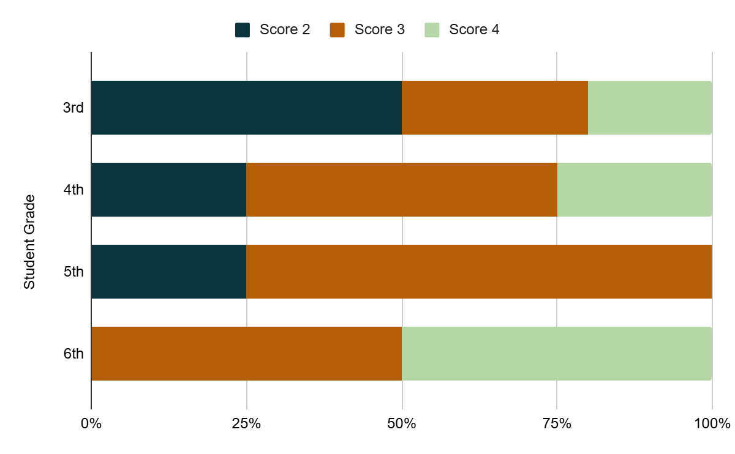
Analyze
Step 7: Prepare the data
50%
30%
20%
Scores by Student Grade
25%
50%
25%
25%
75%
50%
50%
Notes:
And here’s another example if you are looking at a larger number of students. If you export a Google sheet, you can use Google Docs to create a bar chart.
To make this chart, you need to first create a pivot table out of the fields that you want to use. (For additional help, see: https://support.google.com/docs/answer/1272900?hl=en&co=GENIE.Platform%3DDesktop)
Then, you can create the clustered bar chart. (For additional help, see: https://www.businesscomputerskills.com/tutorials/google/how-to-make-a-clustered-bar-chart-in-google-sheets.php)

Slide 27

Analyze
Step 7: Prepare the data
Let’s look more closely at the open-ended responses!
Notes:
Let’s spend a little bit more time thinking about how we can prepare those open-ended responses. You might be especially overwhelmed by all this information. It is incredibly interesting and rich but you may not have time during your data discussion to read through it all. You could consider pulling a sample of quotes from the strengths, areas of improvement, and areas of needs buckets. You may also consider pulling themes within each category.
We’re going to do a little activity together in Mural, to show one way you might go about this.
MURAL link: https://app.mural.co/t/e2c20876/m/e2c20876/1740151998098/01c91c8aa996d4e9e153abc20bb68eb7d175bc2b?sender=u60086c1bfa05bb5989783865
Okay, let’s pretend we are all staff from the fictitious SPR Academy. We just finished the assessment process, and now we’re getting together to look at three questions from the data form (strengths, areas for improvement, and additional support needed). We have the responses to these questions on little virtual sticky notes.
In your groups, read through the data on the sticky notes related to strengths and challenges and group them into the categories shown here. For convenience, we went ahead and created categories that connect to the Relationship Skills rubric but feel free to create an additional category if you identify another theme. You will have 10 minutes to complete this exercise. If you complete the task before the 10 minutes ends, we invite you to go through the same process with the needed program support section.

Slide 28
Analyze
Step 8: Prepare questions ahead of time
Notes:
Before your meet with your staff to discuss the results, you will want to identify some questions in advance to encourage staff to engage with the data. While we have compiled some questions and related resources (all conveniently located in the User Guide), you can also come up with your own.
I want to take a little pause here and give you a chance to sit with those resources I just mentioned. Please turn to the second page of your training workbook. Near the top, you should see “How to Lead Survey Data Discussions.” Please take a few minutes to read the excerpt to yourself. Give me a thumbs up when you are done.
It looks like we are all done so let’s move on. We’re now going to spend some time brainstorming some data questions. Because all of the steps we’ve gone over before have focused on the student assessment, we’re going to shift gears again and think through this step in relation to the staff survey.
This activity is pretty straightforward. Using the mural link below, you will write down potential questions that you could pose to your staff during a data conversation. To help come up with questions, consider the excerpt you just read and think of questions that avoid judgement and that acknowledge missing voices. We are doing this as a large group so please feel free to take a look at some of the other questions your peers have left. We encourage you to use the space in your training workbook to copy and save questions for later.
Mural Activity: https://app.mural.co/t/e2c20876/m/e2c20876/1739307525691/ab2908c6682dfdaf92a8812d4b2c8741209233bc?sender=u60086c1bfa05bb5989783865

Slide 29



Analyze
Step 9: Hold data conversations
  How can you set norms to facilitate a productive discussion?
  How can you record and share what came out of the discussion?
  Who should be in the room?
Notes:
And now, after all that prep, you’d be ready to launch some rich conversations with your staff! Conversations that will allow your team to reflect on program improvement and student development. With that in mind, there are a few considerations when holding these conversations.
First)Think about who should be in the room. Does it make senses to include new staff? Would making the meeting hybrid or remote help all the right players participate?
Second) you may want to consider setting some norms at the start of the meeting. For instance, encouraging staff to honor the lived experiences of the students and acknowledging that people can have different opinions and perspectives. Ultimately, the data does not tell the whole story. Sometimes a reminder that it is okay to not have a solution can be helpful.
Finally, it may be important to figure out how to record and share the learning gained from the discussion. Identifying a notetaker ahead of time an be beneficial. Recordings are also nice if that’s an option.
And of course, I’m sure many of you have engaged in these conversations before.
Does anyone else have any other considerations that folks should keep in mind when they are leading these types of conversations?

Slide 30



Analyze
Step 10: Plan for next steps
  What adjustments will be made?
  Who is responsible for next steps?
  When will the next assessment occur?
Notes:
We don’t want you to go through this process of collecting and making sense of data, and then just let it sit somewhere. Using the data is the most important step. We have some considerations that can help you successfully build on what you learned.
First) Consider what adjustments will be made based on your recent discussion. Perhaps the survey findings indicated a need for more targeted professional development or the student assessment revealed that the SEL curriculum may be more effective for older students than for younger students.
Next) Assign clear next steps to individuals. Assigning ownership and dividing responsibilities can make the process smoother.
Lastly) we recommend you consider when you will administer the assessment next, and if you learned anything from this cycle that could make the process smoother. Now that you have just gone through the process, you have an idea of how long the cycle takes. This can help you align with other program activities.

Slide 31
Thank you for your attention!

